Slide 1
Amazon Elastic Beanstalk

Slide 2
Problems on AWS for a Developer
Managing/Creation Infrastructure
Code Deployment
Configuring databases
Configuring load balancers
Auto Scaling
Monitoring
Logging

Slide 3
Amazon Elastic Beanstalk
AWS Elastic Beanstalk is the fastest and simplest way to get an application up and running on AWS.
Upload your application code, and the service automatically handles all of the details, such as
Resource provisioning
Load balancing
Auto Scaling
Monitoring.
You can quickly deploy and manage applications on the AWS cloud
Reduces management complexity

Slide 4
AWS Elastic Beanstalk Overview
Fully Managed Service
Instance configuration / OS is handled by Beanstalk
Deployment strategy is configurable but performed by Elastic Beanstalk
Just the application code is the responsibility of the developer
Three architecture models:
Single Instance deployment: good for dev
LB + ASG: great for production or pre-production web applications
ASG only: great for non-web apps in production (workers, etc..)

Slide 5
AWS Elastic Beanstalk
Elastic Beanstalk has three components
Application
Application version: each deployment gets assigned a version
Environment name (dev, test, prod…): free naming
You deploy application versions to environments and can promote application versions to the next environment
Rollback feature to previous application version
Full control over lifecycle of environments

Slide 6
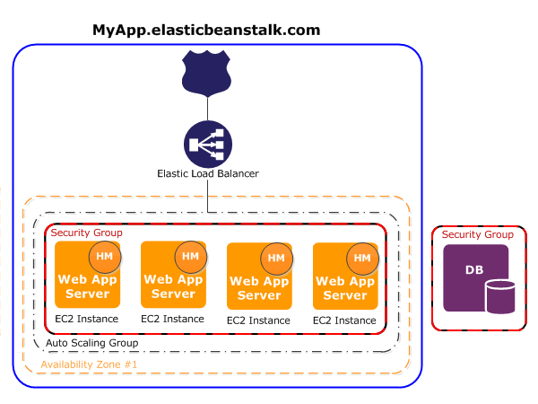

Slide 7
Elastic Beanstalk
Support for many platforms:
Go
.NET
Node.js
PHP
Python
Ruby
Packer Builder
Docker

Slide 8
Elastic Beanstalk Deployment
Elastic Beanstalk supports environments as
Single Instance environments
High Availability with Load Balancer

Slide 9
Beanstalk Deployment Options
All at once
Deployment fastest, but having little downtime
Rolling
Deploy the new version in batches.
Each batch is taken out of service during the deployment phase, reducing your environment's capacity by the number of instances in a batch.
Rolling with additional batch:
Deploy the new version in batches
first launch a new batch of instances to ensure full capacity during the deployment process
Immutable:
Deploy the new version to a fresh group of instances
swaps all the instances when everything is healthy

Slide 10
Deployment Options - All at once
Fastest deployment
Application has a little downtime
Great for quick iterations in development environment
No additional cost
rollback would take time in case of any issues

Slide 11
Deployment Options - Rolling
Application is running below capacity
Can set the bucket size
Application is running both versions simultaneously
No additional cost
Long deployment

Slide 12
Deployment Options - Rolling with additional batch
Application is running at capacity
Can set the bucket size
Application is running both versions simultaneously
Small additional cost
Additional batch is removed at the end of the deployment
Longer deployment
Good for prod env

Slide 13
Deployment Options - Immutable
Zero downtime
New Code is deployed to new instances on a temporary ASG
High cost, double capacity
Longest deployment
Quick rollback in case of failures (just terminate new ASG)
Good for prod env

Slide 14
Method | Impact of failed deployment | Deploy time | Zero downtime | No DNS change | Rollback process | Code deployed to
All at once | Downtime |  | No | Yes | Manual redeploy | Existing instances
Rolling | Single batch out of service; any successful batches before failure running new application version | † | Yes | Yes | Manual redeploy | Existing instances
Rolling with an additional batch | Minimal if first batch fails; otherwise, similar to Rolling | † | Yes | Yes | Manual redeploy | New and existing instances
Immutable | Minimal |  | Yes | Yes | Terminate new instances | New instances
Traffic splitting | Percentage of client traffic routed to new version temporarily impacted | †† | Yes | Yes | Reroute traffic and terminate new instances | New instances
Blue/green | Minimal |  | Yes | No | Swap URL | New instances

Slide 15
Beanstalk Lifecycle Policy
Elastic Beanstalk can store at most 1000 application versions
If you don’t remove old versions, you won’t be able to deploy anymore
To phase out old application versions, use a lifecycle policy
Based on time (old versions are removed)
Based on space (when you have too many versions)
Versions that are currently used won’t be deleted
Option not to delete the source bundle in S3 to prevent data loss

Slide 16
Elastic Beanstalk Extensions
A zip file containing our code must be deployed to Elastic Beanstalk
All the parameters set in the UI can be configured with code using files
Requirements:
in the .ebextensions/ directory in the root of source code
YAML / JSON format
.config extensions (example: logging.config)
Ability to add resources such as RDS, ElastiCache, DynamoDB, etc…
Resources managed by .ebextensions get deleted if the environment goes away

